Slide 1
Analyzing Stakeholder Satisfaction
Presented to Matt Mostofi

Slide 2

Our Team
W0867334
Preeti Sharma
W0859956
Tamanna
Documentation
W0861930
Sahil
Dashboard
Handler
W0865937
Manish Kataria
Data Analyzer
Group Leader

Slide 3
Content
01
02
03
04
05
07
08
Introduction
Objective
Dataset Overview
Dashboard
Insights & Findings
Challenges & Limitations
Conclusion
Understanding feedback patterns to improve engagement and decision-making.
Describe Our goals
Show an interactive dashboard, created with the help of tableau
Represent our result or conclude.
Provide information About our using dataset
Clear updates and follow-ups boosted stakeholder satisfaction.
Limited data and delayed responses affected accurate analysis

Slide 4

Introduction
Brief explanation of stakeholder satisfaction importance
Why the topic was chosen
Project goal in one sentence
[1]

Slide 5
Objectives
01
Measure stakeholder satisfaction across roles and departments.
02
Identify patterns in feedback categories and sentiments.
03
Analyze the relationship between issues raised, resolution time, and satisfaction.
04
Provide actionable recommendations for improving stakeholder communication and engagement

Slide 6
Dataset Overview
Feature | Description
Survey ID | Unique identifier for each response
Stakeholder Role | Role of respondent (Client, Vendor, Sponsor, etc.)
Department | Business unit they interact with (Compliance, Engineering, etc.)
Satisfaction Score | Rating from 1 (Low) to 5 (High)
Feedback Category | Main concern area (Timeliness, Communication, etc.)
Comments Length | Number of words in free-text feedback
Response Sentiment | Sentiment category (Positive, Neutral, Negative)
Engagement Frequency | Avg. interactions per month
Issues Raised | Count of issues reported
Resolution Time | Avg. time taken to resolve issues (in days)
Follow-Up Required | Whether follow-up was needed (Yes/No)

Slide 7
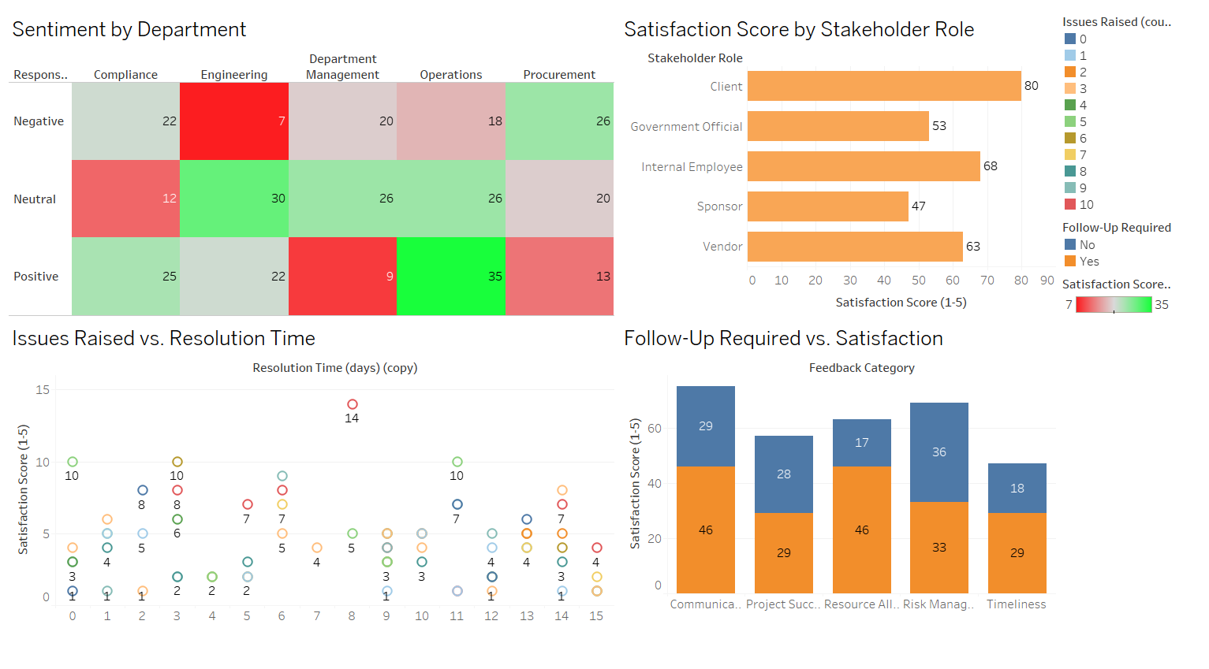
Dashboard

Slide 8
Insights & Findings
Department Feedback
Engagement Matters
1
2
3
4
5
Different Views by Role
Mood and Success
Follow-Ups Help

Slide 9
Challenges & Limitations
The findings might not apply widely without more varied and larger data
Generalization Issues
Emotions were labeled by hand, which could include personal bias
Static Snapshot
Manual Sentiment Classification
The data shows just one moment in time, not changes over time
Small Dataset Size
The limited number of responses makes it hard to use advanced prediction methods.

Slide 10
Conclusion
We used a small but valuable dataset to understand what affects stakeholder satisfaction. By looking at engagement, sentiment, and how quickly issues were solved, we found important areas to improve. With better follow-ups and more active communication, we can make the stakeholder experience much better.

Slide 11
References
Theme of PPT
https://www.free-powerpoint-templates-design.com/businessman-cityscape-powerpoint-templates/\
Image 1
https://www.govexec.com/management/2015/03/what-stakeholder-6-things-you-should-know/107778/
Background Image
https://www.esgvoices.com/post/stakeholder-engagement-plan-esg-strategies

Slide 12
THANK YOU

